Slide 1
TAKE HOME TEST — DATA ANALYST
Delivery Time Analysis
& Courier Efficiency
Food Delivery Platform Case Study — Zomato Dataset
45,584 orders · 20+ cities in India · February–April 2022
⏱
Compiled by
Rio Marselino Perdianto
Data Analyst & Business Intelligence Batch 22
Prepared as part of the Data Analysis & Business Intelligence Bootcamp

Slide 2
ANALYSIS FRAMEWORK
Six Stages of Analysis
01
02
03
Problem Statement & Analysis Objectives
Data Preprocessing
Exploratory Data Analysis
04
05
06
Insight & Interpretation
Interactive Dashboard
Business Insight Recommendations
2

Slide 3
STAGE 1 · PROBLEM STATEMENT
Background & Problem Statement
The company is an on-demand food delivery marketplace operating across 20+ cities in India, connecting restaurants, customers, and partner couriers (gig workers) through an app.
26.3
min average delivery time
PROBLEM STATEMENT
10–54
Delivery times vary significantly, and it is not yet clear which operational factors drive this the most — making it difficult for the company to set courier allocation and readiness policies, especially during high-demand periods like festivals, without sacrificing service quality.
min delivery time range
9.4
standard deviation (minutes)
3

Slide 4
STAGE 1 · PROBLEM STATEMENT
Analysis Objectives & Scope
1
Identify and rank the factors that most influence delivery time — separating factors the company can control from external factors it must anticipate
SCOPE & LIMITATIONS
Find the trade-off point in the order batching strategy (multiple deliveries) — how far it stays efficient before hurting service quality
• Operational/logistics in nature — excludes financial impact (no price data available)
2
• Findings are correlational, not strictly causal
3
Measure the impact of high-demand periods (festivals) as a basis for resource-readiness planning
• Delivery_person_ID is not used to claim individual courier performance
Develop actionable, data-driven operational recommendations, without claiming individual courier performance or financial impact
• Semi-Urban category treated with caution (0.4% sample)
4
• Dataset shows signs of being synthetic/educational — insights are positioned as a business case simulation
4

Slide 5
BUSINESS CONTEXT
Business Model & Dataset Overview
THREE-SIDED MARKETPLACE
45,584
20
🏪
Restaurants (supply)
rows
columns
restaurant coordinates spread widely; the platform owns no kitchens itself
👤
Customers (demand)
2
21+
delivery locations spread widely across cities
months (Feb–Apr 2022)
cities in India
🛵
Partner couriers (gig workers)
own vehicle & rating each — not full-time employees
Target Variable
Additional finding: courier IDs follow the pattern [CityCode]RES[no]DEL[no] — indicating the ID is a system-generated combination, not a persistent individual identity. Coverage spans 21+ Indian cities (Mumbai, Bangalore, Chennai, Kolkata, etc).
Time_taken (min) — total time from order placed to delivered to customer
5

Slide 6
STAGE 2 · DATA PREPROCESSING
Data Quality Issues Found
Issue | Row Count | Resolution
Negative-signed restaurant coordinates | 431 | Fixed with abs()
Restaurant coordinates (0,0) — invalid | 3,640 (8%) | Set to missing
Courier rating > 5.0 (out of scale) | 53 | Set to missing, then median-imputed
Courier age < 18 years | 38 | Kept, flagged transparently
Mixed time format (Excel decimal) | 4,068 | Re-parsed into a consistent time format
Missing values (Age, Ratings, Weather, Traffic, City, multiple_deliveries) | 8 columns, 0.5%–4.2% | Median / mode / "Unknown" imputation
6

Slide 7
STAGE 2 · DATA PREPROCESSING
Cleaning Results & New Features
DERIVED FEATURES (FEATURE ENGINEERING)
DATASET READY FOR EDA
Distance_km
45,356
Straight-line (haversine) distance from restaurant to delivery location
rows — after excluding 228 anomalous cluster rows
Prep_Time_min
Gap between order placed and courier pickup time ("kitchen time")
Additional finding: 228 rows with Festival = missing turned out not to be random — their delivery times were remarkably uniform and far faster (10–14 min) than any other group. Suspected to be a different data cluster (not normal deliveries), so these 228 rows were excluded from the main analysis, not imputed.
Order_Hour / Order_Weekday
Order hour & day, for peak-time patterns
Age_flag_under18
Transparent flag without removing data
7

Slide 8
STAGE 3 · EDA
Which Factors Matter Most?
READING THIS CHART
Festival and traffic conditions are the two categorical factors with the widest range of impact on delivery time.
Numerically (correlation), multiple_deliveries is the strongest (r = 0.376) — and the only factor fully within the company's control through order-allocation policy.
Order type and vehicle type have almost no impact — not a priority target for improvement.
8

Slide 9
STAGE 3 · EDA
Trade-off Point: Multiple Deliveries per Courier
+13.7 min
jump in delivery time from 1 → 2 additional orders — far larger than the increase at any other step
INTERPRETATION
Order batching stays efficient up to 1 additional order. Beyond that, courier "savings" start to hurt service quality disproportionately — not a gradual decline, but a sharp jump.
9

Slide 10
STAGE 3 · EDA
External Factors: Traffic & Weather
Traffic Jam adds ~10 minutes compared to Low. Cloudy/Fog weather is slowest (~29 min) — likely due to low visibility rather than extreme weather itself. Both factors are meaningful but outside the company's direct control — better suited for dynamic ETA estimation than for reduction targets.
10

Slide 11
STAGE 3 · EDA — CRITICAL MOMENT
Festival: A Demand Shock
Regular Day
During Festival
25.98
45.52
min average
min average
+19.5 min (nearly 2x)
This effect holds consistently across all traffic levels — suggesting the cause is a surge in order volume (capacity), not just heavier traffic.
→ The solution lies in courier capacity readiness, not route optimization.
11

Slide 12
STAGE 4 · INSIGHT & INTERPRETATION
Five Key Insights
1
Order-batching trade-off point
Safe threshold is 1 additional order — the only factor fully within the company's control.
2
Festival = a capacity shock
+19.5 min, consistent across all traffic levels — needs resource readiness, not route optimization.
3
External factors must be anticipated
Traffic & weather are real but outside the company's control — their value lies in ETA prediction, not prevention.
4
Vehicle-type anomaly
Motorcycles are slower than scooters — likely assignment bias (longer distances/more complex orders), needs further investigation.
5
Rating & age: correlation, not causation
The direction of cause-and-effect can't be confirmed — should not directly drive HR policy.
12

Slide 13
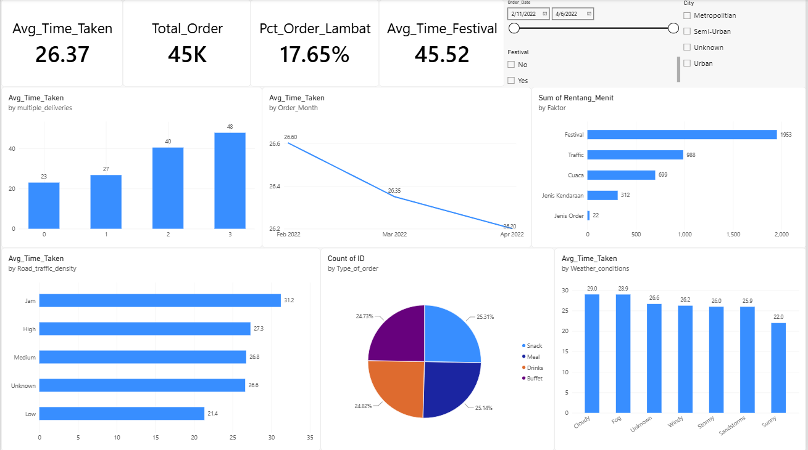
STAGE 5 · INTERACTIVE DASHBOARD
Power BI Dashboard — Single Page
13

Slide 14
STAGE 6 · BUSINESS INSIGHT RECOMMENDATIONS
Recommendations & Execution Priority
# | Recommendation | Impact | Effort | Owner
1 | Cap additional orders at 1 per courier trip | High | Low | Operations / Product
2 | Prepare backup couriers ahead of festivals | High | Medium | Operations / Marketing
3 | Build dynamic ETA based on traffic & weather | Medium | Medium–High | Product / Data Eng
4 | Investigate vehicle-assignment patterns | Medium | Low | Data Analyst
5 | Hold off HR policy based on rating/age | Low | Low | People Analytics / HR
Note: impact is stated qualitatively (High/Medium/Low) because the dataset has no cost/revenue data — financial savings estimates cannot yet be calculated.
14

Slide 15
LIMITATIONS & CONCLUSION
• Findings are correlational, not strictly causal
CONCLUSION
• Delivery_person_ID is not used to claim individual courier performance
Order-allocation policy (capping additional orders) and festival capacity readiness are the two levers with the biggest impact and lowest implementation effort — making them the top execution priority.
• Semi-Urban conclusions are statistically weak (0.4% sample)
• 228 anomalous cluster rows (Festival = missing) were excluded from the analysis
• Dataset shows signs of being synthetic (courier ID pattern, evenly-split order types, odd/even date pattern) — insights are positioned as a business case simulation
External factors (traffic, weather) remain valuable for building more realistic ETAs, even though they can't be eliminated.
• No cost/revenue data — recommendation impact is stated qualitatively
Thank you
Link Github : https://github.com/riomarsel25-arch
15

